Slide 1
Project 930
Team Pig2Rat TechLites
Brian Frank - Team Lead
Xiaoke Hu - Software Engineer
Bharati Pradayini Kandakumar - QA/QE Engineer
Yingqi Mou - Systems Analyst/Engineer
Penny Peng - Product Manager
Mytreyi Reddy - Data Analyst/Scientist
Rujuta Tamhankar - Maintenance/Support Engineer
Powerpoint Template from https://www.free-powerpoint-templates-design.com/
Notes:
Title: 30 Sec

Slide 2
Agenda
Mission
Current Workflow
Business Problem & Requirements
Proposed New Workflow
Project Technical Requirements
Chosen OSS
1
2
3
4
5
6
Risk Analysis
Estimation,
ROI & ROV
SDLC & Key Software Concepts
Persona & User Stories
Competitive & SWOT Analysis
Proposed New System
12
11
10
9
8
7
Roadmap & Project Plan
Testing
Release Plan & Success Criteria
Bug Tracking & Management
Appendix
Bibliography
13
14
15
16
17
18
Notes:
Title: 30 Sec

Slide 3
San Joaquin General (SJG) Hospital Mission
Our mission is to provide services and experiences that are smooth and pleasant to our patients and increase our operational efficiency among our doctors and departments.
Notes:
Title: 30 Sec

Slide 4
About Our Surgery Operations
The hospital saw close to 100,000 clinical visits last year, include wellness check ups, emergency room visits, surgeries and other various medical treatments
Approx 6% of clinical visits (6,000¹) are surgery operations
On average, our 15 surgeons only perform 2 surgeries per day
15 X 200 working day = 3,000 working days
6,000 surgeries / 3,000 working days = 2 surgeries per day
The national average is 3 surgeries per surgeon per day for comparable hospitals
Also, our yearly patient survey ranked “Surgery Scheduling” last among the choices in Hospital Operations
Surgeries are current booked approximately 5 weeks out, while the average for comparable hospitals is only 3 weeks¹
[1] Hypothesized number loosely based on research.
Notes:
Simple: 1 min

Slide 5
Current System
01
Our existing legacy electronic health records (EHRS) system holds information about:
Employees (scheduling admin, doctors, nurses, etc)
Patients (bio/demo, insurance, etc)
Appointments (wellness check up, surgery, physical therapy, etc)
02
The Hospital also has separate databases for facilities and other departments.
03
Being a rural hospital, our scheduling admin are not technologically savvy and are not allowed access to our electronic health records system.
04
Database updates are reserved for IT staff only.
Notes:
Simple: 1 min

Slide 6
Existing Technical Workflow
Gap 1
Step 1
Step 2
Step 3
The patient calls to schedule a surgery.
The scheduling admin records patients info and multiple possible dates into a spreadsheet and sends it to the IT department.
IT loads the records into the legacy EHRS system at the end of the day.
Gap 1: The scheduling admin cannot access employee and facility schedules to see the available surgeon/room/operating room staff to better assist the patient with scheduling a suitable time
Notes:
Simple: 1 min

Slide 7
Existing Technical Workflow
Gap 2
Gap 3
Step 4
Step 5
Every morning, IT produces 3 spreadsheets that are sent to the scheduling admin: 1) consolidated surgery requests, 2) consolidated surgeon schedule and 3) consolidated operating room staff schedule.
The scheduling admin matches the available surgeon and operating room staff to the patient info and surgery type.
Gap 2: The scheduling admin reviews spreadsheets to match available surgeons and operating room staff. It’s very unclear and inefficient to match the best surgeon by comparing the information from three different spreadsheet
Gap 3: The scheduling admin knows which surgeons perform which surgeries, but lacks the domain knowledge to efficiently schedule operating room staff. The nurse unit manager is better equipped to make those decisions
Notes:
Simple: 1 min

Slide 8
Existing Technical Workflow
Gap 4
Step 6
Step 7
Step 8
The scheduling admin sends over the surgery request to the surgery facility to find available rooms.
The scheduling admin books the surgeons, nurses and surgery rooms and updates the surgery request spreadsheet (recorded data includes surgery date/time, surgeon, nurses and facility room).
The scheduling admin sends IT the updated spreadsheets to be committed to the legacy EHRS system.
Gap 4: Facility information is stored outside the legacy EHRS system, which increase the burden for data retrieval
Notes:
Simple: 1 min

Slide 9
Existing Technical Workflow
Gap 5
Step 9
Step 10
IT creates new surgery confirmation record in the legacy EHRS system.
The scheduling admin informs patient of the surgery date time, surgeon and facility.
Gap 5: Scheduling Admin doesn’t have an efficient way of finding surgery information on an ad-hoc basis. They must consult the bulky daily consolidated report.
Notes:
Simple: 1 min

Slide 10
Business Problem Statement
Increasing patient complaints about unsatisfactory surgery experiences due to scheduling mistakes, E.g., operating rooms being double-booked or last minute appointment changes. This stems from scheduling admins not having the critical information needed to properly schedule surgeries
Increasing complaints from our surgeons due to surgeries being incorrectly staffed or understaffed because scheduling admins are ill-equipped to make those types of decisions
Certain types of our surgeries are often arranged densely among the same doctors and operating room staff, resulting in unbalanced workload, stressed and exhausted staff, and a decrease in surgical quality
Without a fix, these problems could result in possible malpractice and increasingly unpleasant patient experience
Notes:
Simple: 1 min

Slide 11
Business Requirements
01
We need a reporting portal that accurately provides critical information regarding surgeons schedules and surgery facility availability so that the scheduling admin can schedule surgeries with the proper combination of facility, surgeon, and operating room staff, thus avoiding double-booking and decreasing scheduling errors
02
We need a reporting portal that provides updated surgery and operating room staff schedules so that the nurse unit manager can balance operating room staff workload and avoid surgeries that are incorrectly staffed or understaffed, thus increasing overall operational efficiency as well as surgical quality
03
We need a reporting portal that provides information regarding surgery outcomes so that the chief surgeon (hospital administration leadership) can better oversee the general surgeon performance, thus providing proper guidance and prompt training
Notes:
Simple: 1 min

Slide 12
Proposed Workflow with New System
Solution 1
Step 1
Step 2
Step 3
The patient calls in to schedule a surgery.
The scheduling admin retrieves relevant reports using the new system while on the phone with the patient
The scheduling admin books surgeon, room, day, and time of the surgery using the new system (This function will be implemented in 2nd launch)
Solution 1 (co-fix gap 1, gap 2, gap 4²): The scheduling admin retrieves surgeon availability report and operating room availability report from the system while speaking with the patient. This allows the patients to have more influence in the scheduling decision. The scheduling admin books the surgeon, room, day ,and time of the surgery right away while on the phone
[2] Please refer to gaps in the presenter's notes section
Notes:
Simple: 1 min
Notes:
Gap 1: Scheduling Admin cannot access Employees and Facilities Schedules to see the available surgeon/room/operating room staff to better assist patient with scheduling a suitable time.
Gap 2: Scheduling Admin reviews spreadsheets to match available surgeons and operating room staff. It’s very unclear and inefficient to match the best surgeon by comparing the information from three different spreadsheet
Gap 4: Facility information is stored in a different database from the EHRS, which increase the burden for data retrieve and store.

Slide 13
Proposed Workflow with New System
Solution 2
Solution 3
Step 4
Step 5
The nurse unit manager schedules the staff for surgery using the new system (This function will be implemented in 2nd launch)
The chief surgeon reviews surgery schedules to make sure the surgeries are properly scheduled
Solution 2 (co-fix gap 2,gap 3): The nurse unit manager retrieves the schedules of operating room staff on a daily basis so that they can staff surgical operations with the appropriate team members
Solution 3 (co-fix gap 1,gap 3): The chief surgeon (hospital administration leadership) reviews surgery schedules from the system on a daily and monthly basis to double check the scheduled surgeons, facilities and operating rooms for the surgeries are appropriate
Notes:
Simple: 1 min
Notes:
Gap 1: Scheduling Admin cannot access Employees and Facilities Schedules to see the available surgeon/room/operating room staff to better assist patient with scheduling a suitable time.
Gap 2: Scheduling Admin reviews spreadsheets to match available surgeons and operating room staff. It’s very unclear and inefficient to match the best surgeon by comparing the information from three different spreadsheet
Gap 3: Scheduling Admin knows which surgeons perform which surgeries, but lacks the domain knowledge to efficiently schedule operating room staff. Nurse Unit Manager knows who to schedule.

Slide 14
Proposed Workflow with New System
Solution 4
Step 6
Innovation
The scheduling admin, nurse unit manager, and chief surgeon review different reports based on their own needs
Solution 4 (fix gap 5): The scheduling admin reviews reports of surgery schedules to double check all the appointments are made correctly and in case on ad-hoc requests for schedule information
Innovation: The nurse unit managers and chief surgeon can review reports of surgery outcomes to better oversee the team performance
Notes:
Simple: 1 min
Notes:
Gap 5: Scheduling Admin doesn’t have an efficient way of finding surgery information if asked. They must consult the bulky daily consolidated report

Slide 15
Project Technical Requirements
01
The reporting system should be able to support the generation of different kinds of reports (charts, graphs, crosstabs, etc) per requirement elicitation feedback from scheduling admin, chief surgeon and nurse unit manager
02
The reporting system should be able to retrieve the data from the legacy EHRS system, as well as from the facilities database and other decentralized data sources
03
The reports should be integrated into our current EHRS system so that staff can easily access them
04
The report generated should display relevant data based on the type of user. This requirement can be achieved by having different login credentials for scheduling admin, chief surgeon and nurse unit manager
Notes:
Simple: 1 min

Slide 16

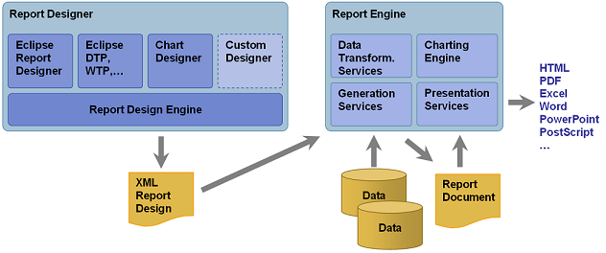
Chosen
OSS
Solution
3
BIRT has two main components³
Visual report designer for creating BIRT Designs
Runtime component for generating designs that can be deployed to any Java environment (such as the front-end of our EHRS system)
Open source business intelligence platform for small businesses
Strong open source community with over 12 million downloads and over 2.5M developers³
Excellent support for essential report features such as⁴
Charts
Crosstabs
Multiple data sources within the same report
Adding custom code
5
[3] Eclipse BIRT Project Home. (n.d.). Retrieved from https://www.eclipse.org/birt/about/
[4] Innovent Solutions. (n.d.). BIRT Review. Retrieved from https://www.innoventsolutions.com/birt-review.html
[5] Eclipse BIRT Project Home: Architecture Overview. (n.d.). Retrieved from https://www.eclipse.org/birt/about/architecture.php
Notes:
Simple: 1 min

Slide 17




Corporate Sponsors¹ and Upstream/Downstream
Corporate Sponsors & Upstream/Downstream
6
7
8
Upstream
9
10
Tribix - Extended Emitters for BIRT
Downstream
[6] Opentext. (n.d.). Unlock the Information Advantage. Retrieved from https://www.opentext.com/
[7] Innovent Solutions. (n.d.). Eclipse BIRT Consulting. Retrieved from https://www.innoventsolutions.com/birt-consulting.html
[8] IBM. (n.d.). Retrieved from https://www.ibm.com/
[9] Eclipse Foundation. (n.d.). Eclipse Logos and Artwork. Retrieved from https://www.eclipse.org/artwork/
[10] Eclipse BIRT Project Home. (n.d.). Retrieved from https://www.eclipse.org/birt/about/
Notes:
Simple: 1 min

Slide 18
Proposed System Diagram
Scheduling
Admin
Chief
Surgeon
Nurse Unit Manager
….
User Interface
Functions Layer
User Input to the system & System Report output to frontend
Application
SJG Reporting and Scheduling System
System’s API Layer
Call BIRT and receive data from BIRT
BIRT
BIRT
BIRT’s API Layer
BIRT’s API to extract and input data from different data sources
Database
EHRS
Facilities
DBMS
Notes:
Simple: 1 min

Slide 19
Data Flow
1. User requests a report
Format: Button click, Text
2. System generates a query with inputted data and calls BIRT API
3. BIRT requests data from the appropriate data sources
SJG User
Interface
SJG System
BIRT
Data Source
6. A beautified and integrated report is displayed to the user
Format: HTML
5. Generated report is sent from BIRT to SJG system
Format: JSON, HTML, Excel, PDF, Doc, etc
4. Data is retrieved from the data source
Format: JSON, XML
Notes:
Simple: 1 min

Slide 20
Competitive Analysis¹¹
Competitive Analysis¹ of Options
 | BIRT
Eclipse Public License (EPL)
Windows, Linux, Mac OS X
YES
XML (RPTDESIGN)
YES
YES
YES
YES
 | Jaspersoft Studio
JasperReports Lib LGPLV3 JasperSoft Studio EPL
Windows, Linux, Mac OS X
YES
Report design files compile to Java Byte Code Deploy/Run .JASPER files
YES
YES
YES
No (Always scroll down even if crosstab expands side-by-side)
 | Pentaho
Pentaho Reporting LGPL V2.1 (or later)
Windows, Linux, Mac OS X
YES
XML Report file (.PRPT) is a ZIP of Design and other resources
YES
YES
No (Experimental)
No
License
Designer Platform
Eclipse Plug-in Available
Report Format
Sub-Reports
Side-by-side Report Components
Cross-tabs
Horizontal Planning
[11] Comparison Matrix. (n.d.). Retrieved from https://www.innoventsolutions.com/comparison-matrix.html
Notes:
Simple: 1 min

Slide 21
SWOT Analysis¹²
Strengths
Includes a report builder
Supports dynamic parameters for reports
Includes graphical data representation
Compatible with Linux OS
Can connect to MySQL database using an JDBC driver
Simple to configure on various web servers
Reports are easy to deploy
Opportunities
Open-source online support available
Ability to extend to fit hospital’s needs through open-source development
Currently maintained and developed
Weaknesses
Threats
Does not include a web server
Training is not include, must be purchased from 3rd party vendors
Better solutions may come along
Corporate sponsors may drop off the project
[12] Adapted from Green, P. (n.d.). An Analysis, Design, And Implementation Of A Business Intelligence Solution For Powerplay Mobile (pg. 18). Retrieved from https://csb.uncw.edu/mscsis/complete/pdf/patrickgreencapstone.pdf
Notes:
Simple: 1 min

Slide 22
Persona and User Stories
Notes:
Title: 30 Sec

Slide 23

Persona 1: Andrea Daily (Scheduling Admin)
Andrea Daily moved to Stockton, CA just 3 years ago at the age of 31. She and her husband, David, were looking to get away from the grind of the bay area, where Andrea worked in transportation management. She was very excited to make the switch to the healthcare industry.
In her spare time, Andrea is an avid runner and attends weekly yoga classes. On the weekends, she volunteers at the local food pantry. She also loves to read cheesy romance novels as a guilty pleasure.
She and David have a dog, Rufus, and 2 cats, Will and Grace (yep, named after the TV show).
13
[13] CottonBro.Retrieved from https://www.pexels.com/photo/woman-wearing-orange-blazer-showing-thumbs-up-3201694/
Notes:
Simple: 1 min

Slide 24
User Story by Scheduling Admin
Epic User Story
Acceptance Criteria
1
As a scheduling admin, I want more access to information about the surgeons and operations rooms, so that I can be more efficient when scheduling surgeries
Scheduling admin can view the availability of surgeons and operating rooms
Level 1 User Story
Acceptance Criteria
1.1
As a scheduling admin, I want to be able to review available information while speaking with the patient so that the patient can have input into the details of their surgery
Scheduling admin can view the availability report of surgeons and operating rooms
1.2
As a scheduling admin, I want to be able to access all scheduled surgeries and the associated surgeons and rooms so that I can confirm surgery information
Scheduling admin can view reports of scheduled surgeries, associated surgeons and rooms
Notes:
Simple: 1 min

Slide 25
User Story by Scheduling Admin
Level 2 User Story
Acceptance Criteria
1.1.1
As a scheduling admin, I want to be able to choose specific days and times to view surgeon’s schedules so that I can propose the best fit for the patient
Scheduling admin can view the availability report of surgeons, filtered by day and time
1.1.2
As a scheduling admin, I want to be able to choose specific days and times to view operating room schedules so that I can propose the best fit for the patient
Scheduling admin can view the availability report of operating rooms, filtered by day and time
1.2.1
As a scheduling admin, I want to receive a daily report of all scheduled surgeries for the next 2 days so that I can confirm any unconfirmed appointments
Scheduling admin receives daily report of surgeries for the next 2 days, including surgery type, surgeon name, operating room, patient information and confirmation status
1.2.2
As a scheduling admin, I want to be able to search for appointments based on patient information so that I can provide the appropriate surgery information on an ad-hoc basis (i.e. patient calls to confirm)
Scheduling admin can search by patient name and view the associated surgeon, operating room, day, and time
Notes:
Simple: 1 min

Slide 26

Persona 2: Dr. Allen Hirschel (Chief Surgeon)
Dr. Allen Hirschel is a well-known Surgeon in the area. After attending Stanford Medical School, Dr. Hirschel found his way to San Joaquin General in a call to do more for this rural community.
Among other talents, Dr. Hirschel is a History buff with keen interest in the early days of the American West. He also enjoys playing cards and going to country western concerts.
Dr. Hirschel and his wife Nancy have 2 kids, Allen Jr. (age 13) and Sophia (age 10). They live just outside of Stockton, but can be found most weekend at their cottage near South Lake Tahoe.
14
[14] Pixabay Stock Photo Retrieved from https://pixabay.com/photos/doctor-dentist-dental-clinic-1149149/
Notes:
Simple: 1 min

Slide 27
User Story by Chief Surgeon
Epic User Story
Acceptance Criteria
2
As a chief surgeon, I want access to more surgery scheduling information so that I can better oversee the team of surgeons
Chief surgeon can view the surgery schedules and surgeon schedules
Level 1 User Story
Acceptance Criteria
2.1
As a chief surgeon, I want to be able to see reports of surgeon schedules, sent on a daily and monthly basis, so that I can make sure the workload is being distributed evenly among surgeons
Chief surgeon can review daily and monthly reports about surgeon schedules
2.2
As a chief surgeon, I want to be able to see reports about surgery outcome, sent on a daily and monthly basis, so that I can oversee the outcomes of surgery operations
Chief surgeon can review daily and monthly reports about surgery outcome
Notes:
Simple: 1 min

Slide 28
User Story by Chief Surgeon
Level 2 User Story
Acceptance Criteria
2.1.1
As a chief surgeon, I want a daily report showing the number of surgeries performed by each surgeon for the upcoming week to make sure the workload is being distributed evenly
Chief surgeon can review daily reports about surgeon schedules for the upcoming week, showing the number of surgeries performed by each surgeon
2.1.2
As a chief surgeon, I want a monthly report showing the previous month’s surgery data, sorted by surgeon so that I can review each surgeon’s workload
Chief surgeon can review monthly reports showing the previous month’s surgery schedules, including surgery type, surgeon name and number of surgeries for that surgeon
2.2.1
As a chief surgeon, I want a daily report showing the outcomes of the surgery operations, so that I can better review the performance of the surgeons and provide needed training or assistance
Chief surgeon can review daily reports about surgery outcomes, including surgery overtime, recorded patient complaint, surgery result and surgeon’s comments about operating room staff
2.2.2
As a chief surgeon, I want a monthly report showing the outcomes of the surgery operations, so that I can better track the surgery performance tendency and provide strategic suggestions or guidance
Chief surgeon can review monthly reports about surgery outcomes, including surgery overtime, patient complaint, surgery result and surgeon’s comments about operating room staff
Notes:
Simple: 1 min

Slide 29

Persona 3: Jackie Hillford (Nurse Unit Manager)
Jackie grew up in Sacramento and is the daughter of immigrants. She graduated from Sacramento State University with her BS in Public Health and then continued her education in their Resident Nursing program, all while holding multiple part time jobs to make ends meet.
Jackie enjoys spending time with her family, especially her younger brother, who is 10 years younger than her. She grew up playing soccer and now plays recreationally on an indoor soccer team.
Since she’s started her nursing career, she finally feels her family is achieving the American dream.
15
[15] Voltamax. Retrieved from https://pixabay.com/photos/nurse-medicine-doctor-hospital-2019420/
Notes:
Simple: 1 min

Slide 30
User Story by Nurse Unit Manager
Epic User Story
Acceptance Criteria
3
As the nurse unit manager, I want access to more surgery scheduling information so that I can better assign each surgery with operating room staff
Nurse unit manager can review surgery schedule, surgeon schedule and operating room schedule
Level 1 User Story
Acceptance Criteria
3.1
As the nurse unit manager, I want a report of operating room staff schedules sent on a daily and monthly basis so that I can better staff surgical operations with the appropriate staff
Nurse unit manager can review daily and monthly reports of operating room staff schedules
3.2
As a nurse unit manager, I want a monthly report showing surgery outcomes and surgeon’s review, grouped by operating room staff, so that I can evaluate the operating room staff performance
Nurse unit manager can review monthly reports about surgery outcome by operating room staff
Notes:
Simple: 1 min

Slide 31
User Story by Nurse Unit Manager
Level 2 User Story
Acceptance Criteria
3.1.1
As a nurse unit manager, I want a daily report showing the current staffing of surgeries for the upcoming week so that I can know which newly booked appointments need to be staffed
Nurse unit manager can review daily reports about staff schedules of surgeries for the upcoming week
3.1.2
As a nurse unit manager, I want a daily report showing the availability of operating room staff for the upcoming week so that I can schedule the operating room staff for newly booked appointments
Nurse unit manager can review daily reports about operating room staff availability for the upcoming week
3.1.3
As a nurse unit manager, I want a daily report showing the number of daily surgery shifts of each operating room staff for the next upcoming week so that I can better distribute the workload or reshuffle the shifts if needed
Nurse unit manager can review daily reports about the number of daily surgery shifts of each operating room staff
3.2.1
As a nurse unit manager, I want a monthly report showing surgery outcome and surgeon’s review associated with each operating room staff, so that I can evaluate the performance of the operating room staff and provide needed training or assistance for improvement
Nurse unit manager can review monthly reports about surgery outcome and surgeon’s review by each operating room staff
3.2.2
As a nurse unit manager, I want a monthly report showing the summary of surgery outcome grouped by surgery type, so that I can track the history of surgery performance and assess the effectiveness of training program for operating room staff
Nurse unit manager can review monthly reports showing the summary of surgery outcome grouped by surgery type
Notes:
Simple: 1 min

Slide 32
SDLC and Key Software Concepts
Notes:
Title: 30 Sec

Slide 33
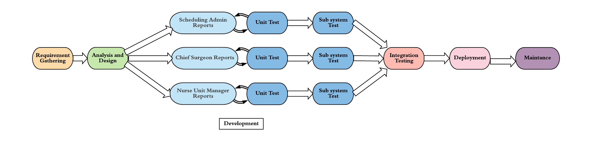
SDLC
We will be using a hybrid SDLC: a traditional waterfall model for the entire project, an incremental model for the development and unit testing, RAD for integration and deployment
The development is broken down into three independent increment:
Scheduling Admin Reports
Chief Surgeon Reports
Nurse Unit Manager Reports
Finally, once the system passes the appropriate tests, we will deploy the application
Notes:
Simple: 1 min

Slide 34
User Experience
“The next big thing is the one that makes the last big thing usable” - Blake Ross
App displays accurate surgeon schedules and operating room schedules in a specific time and date basis for the scheduling admin
App enables conditional search to look up patient’s name and presents date and time of surgery, and selected surgeon for the scheduling admin
App shows easily readable reports containing surgery scheduling information and staffing for the nurse unit manager
App provides clear daily and monthly report about surgeon's workload for the chief surgeon
Notes:
Simple: 1 min

Slide 35

Engineering Productivity
“If you’re not running scared, you have bad security or a bad security product.” - Roger G. Johnston
Selected framework, programming languages, and libraries are:
Familiar to software engineering team or easy to learn which could shorten developing period and decrease bugs.
Easy to generate test scenarios
Able to display the appropriate plotting functions needed for the reports
Notes:
Simple: 1 min

Slide 36
Cache
To build a functionally efficient app, caching is one of the most significant aspects. Advantages include¹⁶:
Optimize app latency
Content availability
Example: When the network is off, nurse unit manager and chief surgeon need to check the daily/monthly report, cache enable the system provides the report in offline mode.
Avoids network congestion
Example: If the nurse unit manager wants to retrieve a 3 month report for team staff performance evaluation, cache would help to avoid network congestion when they want to see a longer time period information.
“Big wins from low-hanging fruit.” -Alex Landau
[16] Vinit S. (n.d.). How Caching Helps In Improving Performance Of Application. Retrieved from https://www.clariontech.com/blog/how-caching-helps-in-improving-performance-of-the-application
Notes:
Simple: 1 min

Slide 37
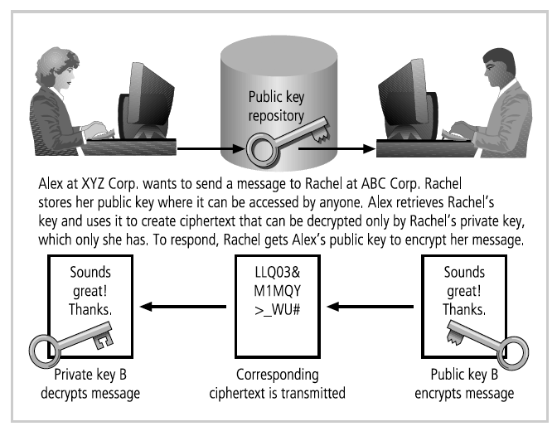
Data Security
Internal:
Limit data warehouse access for operational employee
Generate APIs and query architecture to provide reports
Tables and charts to satisfy their work requirement.
How it helps:
Mitigate data leaking and data tampering from internal hacker
Prevents accidentally modification or deletion of data by non-technical professionals
“The more money that can be made from defeating a technology, the more attacks, attackers, and hackers will appear.”
~Roger J Johnston
External:
Front-end code encryption is used to avoid data and information leaking in the case of a data breach by an expert hacker
Applied asymmetric encryption will help to protect data security during the data connection.
[17] Whitman, M. E., & Mattord, H. J. (2012). Principles of Information Security (pg. 368) (4th ed.). Andover, England: Cengage Learning EMEA.
Notes:
Simple: 1 min

Slide 38
Query Architecture & Filtering Criteria
Facilities
DBMS
Employee Availability
Facilities Availability
Newly Scheduled
Surgery Info
Yes
SJG system display reports on frontend
Schedule
Appointment
EHRS¹⁸
DBMS
Dates¹⁹
SJG
System
User
Interface
No
Scheduled
Appointments
Patients
Info²⁰
Scheduled
Surgeries Reports
Decision Point
Data Source
Filtering Criteria
BIRT
Result of Filtering
Reports
Destination
[18] Electronic Health Records System
[19] Specific dates that user wants to schedule appointments, patients desired dates, or the dates on which user want to retrieve reports
[20] Optional filtering Criteria. If users want to retrieve all scheduled appointments, this criteria is not needed
Notes:
Simple: 1 min

Slide 39
Exception Handling
Raise I/O Exception
Display the data error message
No
No
Data Input
Output
Success
Receive Exception
From Previous Step
Display Reports
Success
BIRT
SJG System
No
Yes
User
Interface
Display Report
Yes
Yes
Send Data
Display user friendly error page
Scheduling Admin Examples in Major I/O Exceptions that might crash the system²¹:
When the admin trying to write the customer insurance information file, but database memory space was no longer available.
In the process of scheduling, the reading action of network file fails to connect.
The system uses a stream to read the patient appointment data, but one process closes the stream immediately.
The scheduling admin tries to assign specific surgeon for the patient, but the account doesn’t have permission to accomplish the task.
[21] Adapted from Java - What throws an IOException. (n.d.). Retrieved from https://stackoverflow.com/questions/13216148/java-what-throws-an-ioexception
Notes:
Simple: 1 min
Notes:

Slide 40
Estimation, ROI and ROV
Notes:
Title: 30 Sec

Slide 41
Total Cost and Saving Estimation
Costs | Year 1 | Year 2 | Year 3
Salary to IT team for entire Development²² | $164,700 | - | -
Network Configuration/Hardware | $35,000 | - | -
Process Improvements | $20,000 | $15,000 | $8000
Application Maintenance Costs | - | $50,000 | $50,000
Total Cost of Investment | $219,700 | $65,000 | $58,000
Savings | Year 1 | Year 2 | Year 3
Increase in Revenue from Outpatient Volume | $62,500 | $196,875 | $452,850
Increase in Revenue from Inpatient Surgeries | $100,000 | $189,000 | $274,800
Total Savings | $162,500 | $385,875 | $727,650
[22] Dev Test for Scheduling Admin -> Surgeon Availability Report. (n.d.). Retrieved from https://docs.google.com/spreadsheets/d/1btxJGkDpSYbc0Sas5WuQwwLrQ94VlocbLuQNgsAdvDw/edit#gid=0
Notes:
Simple: 1 min
Notes:
The 1st year incurs greater costs compared to 2nd and 3rd year due to project management, requirement, analysis, development, testing, training, process improvement and hardware expenses.
According to the Waterfall Increment model, each phase has certain costs incurred in the entire process.
1 product manager, 2 analysts, 2 software developers, 1 testers and 1 deployment engineer are required to work on the proposed system for a timespan of 4 months during year 1 and each of them are paid accordingly to their position and work hours.
The total cost estimate for IT teams is calculated based on the allocation in project plan.

Slide 42
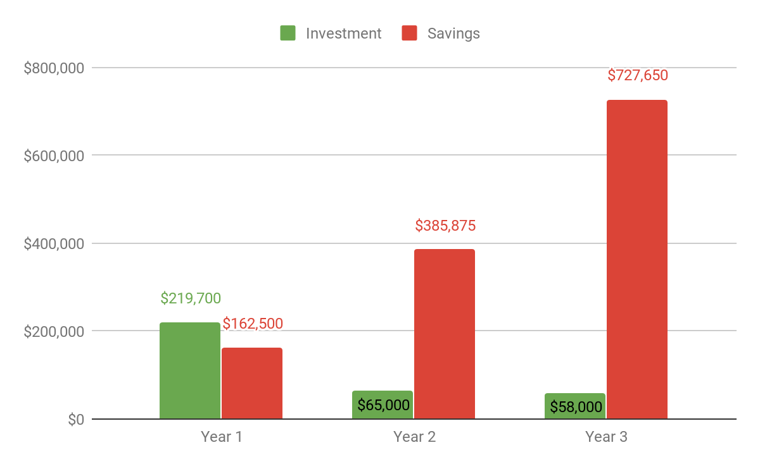
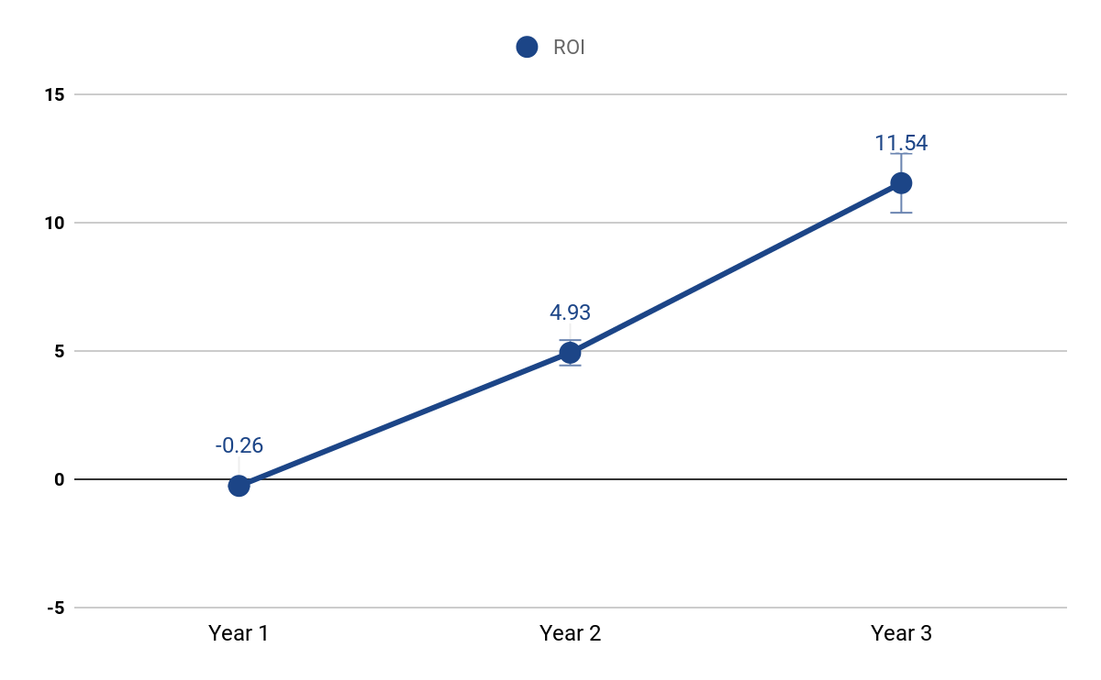
Return on Investment
 | Year 1 | Year 2 | Year 3
Total Cost of Investment | $219,700 | $65,000 | $58,000
Total Savings | $162,500 | $385,875 | $727,650
Return on Investment | -0.26 | 4.93 | 11.54
Notes:
Simple: 1 min

Slide 43
Return on Value²³
 | Resource optimization
 | Surgery schedule optimization and proper resource allocation leads to better utilization of resources and, in-turn, more surgeries.
 | Patient Satisfaction
 | Patient satisfaction improves by reducing wait times, quicker call-back responses from medical staff, and increased scheduling availability
[23] Healthcare KPIs & Metrics - Explore Healthcare KPI Examples. (n.d.). Retrieved from https://www.datapine.com/kpi-examples-and-templates/healthcare
Notes:
Simple: 1 min

Slide 44
Risk Analysis
Notes:
Title: 30 Sec

Slide 45
Risk Table
 | Probability | Severity | Priority | Mitigation/Avoidance
Risk associated with data breach, specifically HIPAA requirements | High | High | High | Database access permissions are granted according to authorization level (based on persona and). Database is only accessible via Ethernet, and only within the hospital network/premises.
Risks associated with inadequate architecture, performance, quality²⁴ | Medium | High | High | Simulate or prototype the system and get benchmark of the system
Risks associated with any conversions of existing data, or clean up of “dirty” data from legacy database, required before implementation of a new system²⁵ | Medium | High | High | Invest in first-class data quality software and consider hiring a specialist firm to assist. Assign the rights to create, approve, edit, or remove data from the source system to the skilled and authorized team members.²⁶
Risk associated with hiring consultants from outside | Medium | High | High | Ensure that high quality consultants are hired, they are experts and highly equipped with the technical skills. Employees will cross-train with consultants to take advantage of knowledge transfer.
Notes:
Simple: 1 min

Slide 46
Risk Table
 | Probability | Severity | Priority | Mitigation/Avoidance
Risk associated with the Integration of new software tools with legacy system | High | Medium | Medium | Validate the data and results at each stage of the development process to ensure that bugs are not carried forward and they are resolved as soon as identified.
Risk associated with end-users not adopting the new reporting system | High | Medium | Medium | Conduct extensive user training including developing super-users to help lead training workshops
Project team members will not be in place²⁷ | Medium | Medium | Medium | Plan for staffing resource and assign backup person for each critical technology: Currently out of scope but will be taken into consideration in the later phases of the project.
Acquisition of hardware and software resource¹ | Low | Low | Low | Hardware and software needs for the project are satisfied. Additional cost is assigned for the Deployment Engineer for maintenance of the application.
Notes:
Simple: 1 min

Slide 47
Roadmap and Project Plan
Notes:
Title: 30 Sec

Slide 48
Roadmap: July 1, 2020 - June 30, 2021
Real-time scheduling function go live (real-time input and update)
4th Month
8th Month
12th Month
Reporting platform go live (view only reports)
Self-service reporting and analytics platform go live
Notes:
Simple: 1 min

Slide 49
First Launch Checklist
Timely basis | Status report | Workload report | Performance report
Daily | Surgeon availability Staff availability Facility room availability Confirmed surgery Current staffing status | Surgeon workload Staff workload | Surgeon performance Staff performance
Monthly | -- | Surgeon workload | Surgeon performance Staff performance
Ad hoc | Patient’s info and associated surgery | -- | --
Notes:
Simple: 1 min

Slide 50
Dev-test Project Plan Milestones
6
Data Engineering Complete
5
UI Engineering Complete
4
3
Report Complete!
2
Testing Phase Complete
1
Development Phase Complete
Data and UI Integration Complete
Notes:
Simple: 1 min

Slide 51
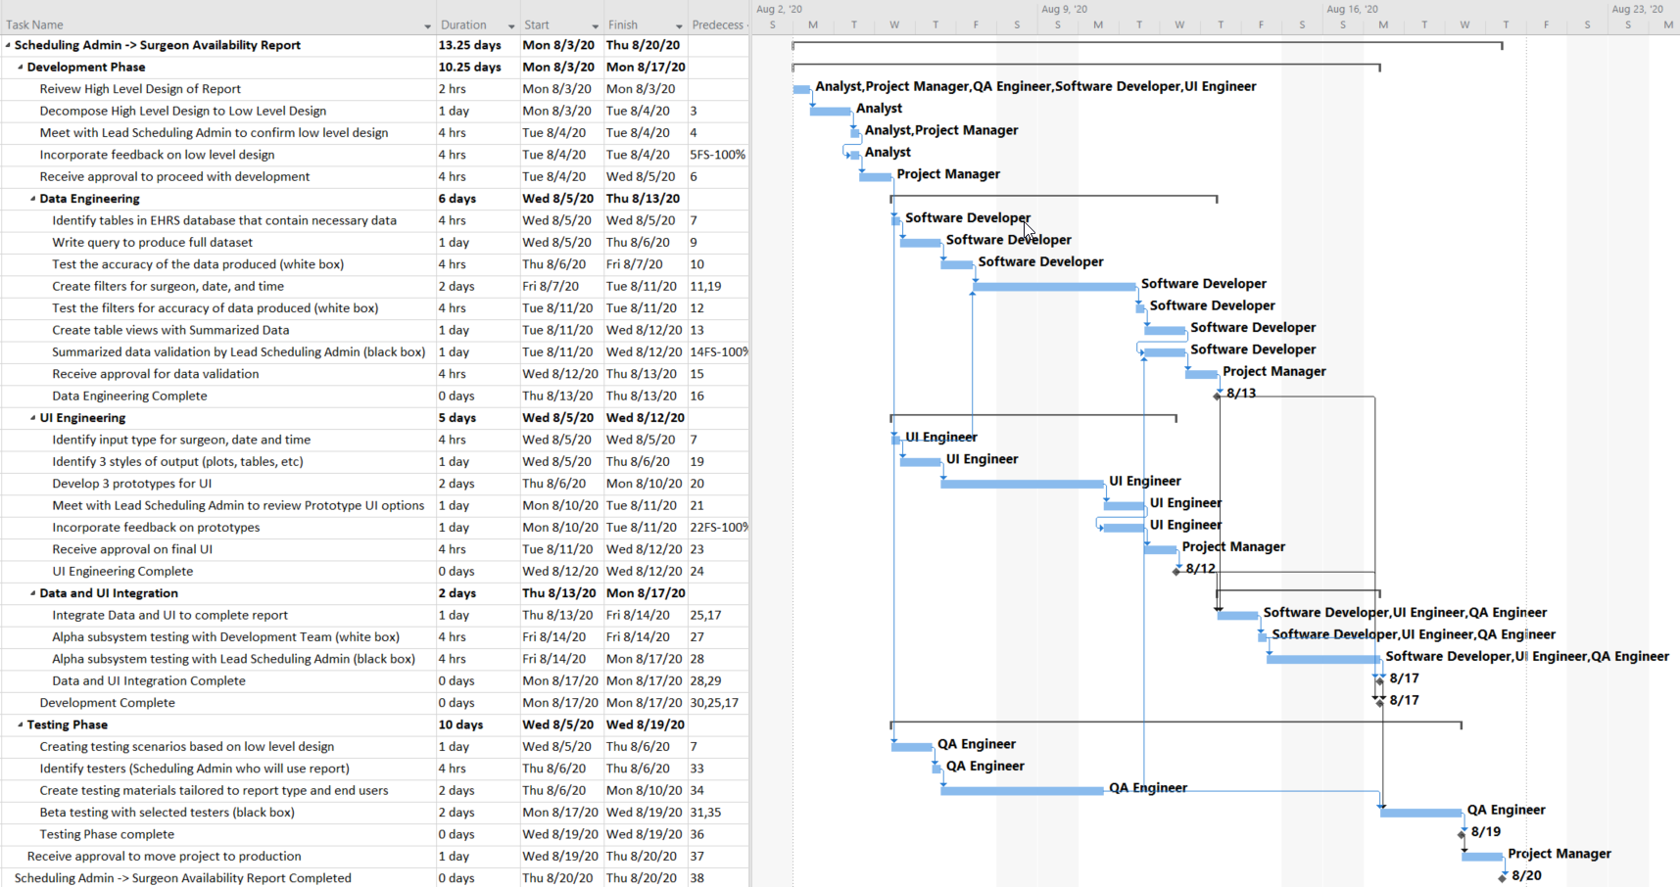
Project Plan: Scheduling Admin - Surgeon Availability Report
Notes:
Simple: 1 min
Notes:
This project plan is for creating 1 report for 1 persona.
This project plan will be repeated over and over in an incremental fashion in order to create all the reports desired by the 3 persona.
Certain portions of the project plan overlap for various reasons:
Data and UI: The report can be split into data and UI. While these two are very dependent on each other, they can be produced in parallel
During certain periods two associated tasks overlap. This happens 3 times during the plan
Low level design
Summarized data
UI prototyping

Slide 52
Testing
Notes:
Title: 30 Sec

Slide 53
Unit Tests
White box testing is performed as each feature is developed during the incremental development phase by developers
Data Migration
Ensure that the data retrieved from the data sources(EHRS and Facilities) such as list of surgeries, unique surgeons in different departments, staffs and available operating rooms by BIRT API have no data loss and with 100% data consistency
3 Modules: Scheduling Admin, Chief Surgeon, Nurse Unit Manager reports
Ensure that all functions in the development of each of these reports are unit tested with both positive and negative test cases
A few examples of functions to be unit tested are calculating the surgery success rate, room availability count and surgeon availability for a particular type of surgery.
Notes:
Simple: 1 min

Slide 54

Subsystem Tests
Black box testing will be carried out for every increment of the model without reference to the internal structure of the component or system.
Correctness and consistent behavior of the sub system by checking interactions between different units/functions. Functionality flow for each sub system are tested using mock data.
Nurse Unit Manager Subsystem : Checking staff workload, performance and assigning staff
Chief Surgeon Subsystem: Checking surgeon availability, their success rates and surgeon allocation
Schedule Admin Subsystem: Check room availability, criticality of surgeries and scheduling surgery
Tests are done from a user’s point of view by testers and will help in exposing discrepancies in the specifications
28
[28] Limbachiya, N. (2019, February 8). Black Box Testing Techniques for Security- Your Guide. Retrieved from https://www.kiwiqa.com/black-box-testing-techniques-for-security-your-guide/
Notes:
Simple: 1 min

Slide 55
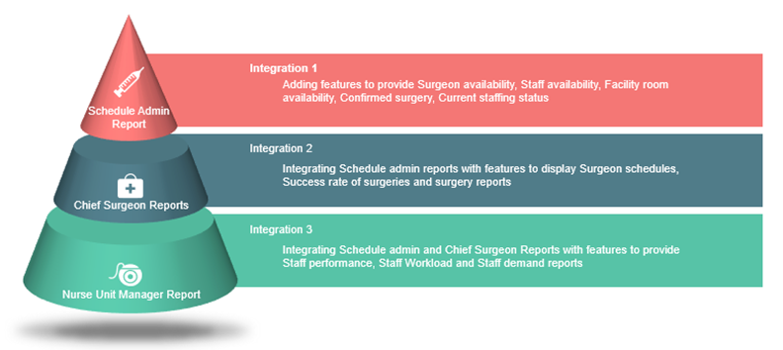
Integration Tests
Using the incremental testing approach, we combine each module incrementally and test the high-risk areas in the integrated application such as scheduling surgeries early, calculation of success rate of surgeries and assigning surgeons based on the criticality of surgeries.
Regression testing is done to make sure none of the changes made over the course of the development process have caused new bugs
Integrated modules are tested together to ensure successful integration and consistent behavior of the system when brought together
Notes:
Simple: 1 min

Slide 56
System Tests
End to end testing of the fully integrated applications including external peripherals in order to check how components interact with one another and with the system thus meeting release criterias
Hardware/Software Test
Test system integration with hardware and focus on the interactions between hardware and software
Performance Test
Test system to make sure its stable and performance is maintained even under simulating three times the workload as the workload of the hospital in the past one year.
Functionality Test
Test the entire flow from different employee login to viewing multiple reports and to scheduling appointments/surgeries
Fuzz Test
Test system to ensure correct behavior even if incorrect or invalid data is provided
Interoperability Test
Test that the new system integrated with the existing legacy system properly and that the behaviour of both the systems are correct and consistent
Security Test
Test the system to ensure it is not affected by security breaches or data theft
Notes:
Simple: 1 min

Slide 57
User Acceptance Tests
After successful completion of system testing, Beta testing is performed by different employees of the hospital such as Scheduling Admin, Chief surgeon and Nurse Unit Manager
End to end GUI testing with beta users of all persona types are performed for scenarios such as
Scheduling surgeries for patients based on criticality and availability of surgeons and rooms
Assigning surgeons after evaluating their performance and surgery success rate
Evaluating nurse working hours, experience and assigning staff for surgeries
Focuses also on security and user specific access controls are checked such as
Nurse unit manager should not able to view surgeon performance reports
Schedule admin does not have access to staff performance reports
Data mockups are created to test and no actual patient information to be used initially.
Notes:
Simple: 1 min

Slide 58
Release Plan and Success Criteria
Notes:
Title: 30 Sec
Notes:
Due to the small size of our project and the relative independence of each increment, there is a great deal of flexibility in our branch, build, and release plans

Slide 59
Branch
Plan
The release branches will be separate from the main branch
From the main branch, we will have 3 separate feature branches
Scheduling Admin Reports
Chief Surgeon Reports
Nurse Unit Manager Reports
Feature branches will be integrated with the main branch daily based on completed work.
Feature branch merges will use minimal continuous integration²⁹ with quality gates due to the fact that each set of reports is completely independent
Feature branches that do not meet the quality gates will not be included in any builds for that day
For all branches, code will be pulled from root to branch and then merge branch to root³⁰
Bug fix branches will be handled on an ad hoc basis
[29] Crouch, A. (2018, November 14). Picking the Right Branch-Merge Strategy. Retrieved from https://www.agileconnection.com/article/picking-right-branch-merge-strategy
[30] Chang, L (2020) Software Project Management: Management Tools, 13 [Powerpoint Presentation] Santa Clara University Camino Learning Management System
Notes:
Simple: 1 min

Slide 60
Release
Plan
Releases
Major releases will occur when roadmap milestones are completed
Reporting System (1.0)
Real-Time Scheduling (2.0)
Self-Service Reporting and Analytics (3.0)
Minor releases will occur on an ad hoc basis when a significant change had occurred from the previous release
New sets of reports not currently in the system (1.X)
New ability to enter data (2.X)
Notes:
Simple: 1 min

Slide 61
Release
Criteria
Zero high priority risks
The unit tests and integration tests should have at least 70% code coverage
User specific access to different types of employees based on their login and access permissions to ensure system security
The application must undergo extensive user acceptance testing for a minimum of 200 end user hours for critical features and 100 hours for any supporting features
All user acceptance tests have been approved
All bugs found during the testing phase, should be properly documented and resolved
All errors encountered have a error message
Unresolved bugs should have recorded documentation and workaround
Modules that are part of the release are verified by users from different departments before release
All known risks should have minimal impact along with an avoidance/ mitigation plan in place
System should be stable under load testing thus supporting approximately 50 concurrent users
New system must work as expected when integrated with existing system
Notes:
Simple: 1 min

Slide 62
Success Metrics
Query response time is less than 500ms
At least 90% of current employees should use the system with ease after a month of each major release which will be measured using user access surveys taken weekly
Time to schedule surgeries measured after each release and should effectively be reduced to half after a month of final release
At least 50% faster staffing using the new system which will be measured based on weekly surveys collected from end users regarding staffing efficiency using the new system
Reports are generated and made available in less than 3s
Notes:
Simple: 1 min

Slide 63
Bug Tracking and Maintenance
Notes:
Title: 30 Sec

Slide 64
Bug Tracking and Management
We will be using “JIRA” software to record and track bugs internally during all stages of SDLC.
For each bug, an issue (ticket) will be created with the relevant details like project name, issue type, severity level, summary, description etc.³¹
For issues like software bugs, project tasks can be reported by QA team. Errors in the generated reports can be reported by the business users.³¹
The business users can report the errors using “ZENDESK” platform as they won’t have direct access to JIRA platform.
The data related issues are considered high priority as the accurate data needs to be reflected in the generated reports.
[31] Atlassian. (n.d.). Bug Tracking - Jira Software. Retrieved from https://www.atlassian.com/software/jira/bug-tracking
Notes:
Simple: 1 min

Slide 65
Bug Tracking and Management
The issues in the generated reports are to be addressed in the development environment as well as post deployment.
Once the bugs are captured, they will be ranked and prioritized based on the importance and urgency of the issue and the team's workload capacity³²
All the bugs will be assigned to the concerned resources with specific time period for resolution.
Every team member will have access to the JIRA dashboard so that everyone is aware of who is working on which issue.
Once the issue is resolved or worked on, the status will be updated accordingly.
[32] Atlassian. (n.d.). Bug Tracking - Jira Software. Retrieved from https://www.atlassian.com/software/jira/bug-tracking
Notes:
Simple: 1 min

Slide 66
Maintenance
Corrective Maintenance
Preventive Maintenance
This includes modifications and updations done in order to correct or fix problems, which are either discovered by user or concluded by user error reports.³³
We will check the accuracy of the generated reports on a timely manner and correct the errors if any.
This includes modifications and updations to prevent future problems of the software. It aims to attend problems, which are not significant at this moment but may cause serious issues in future.³³
We would anticipate the future issues in advance and take proper measures to mitigate them.
Corrective Maintenance
Preventive Maintenance
Adaptive Maintenance
This includes modifications and updations applied to keep the software product up-to date and tuned to the ever changing world of technology and business environment.³³
We would check regularly with our users if the reports suffice their needs or they need any modifications. If any modifications are required in an existing report, we would perform system enhancement and change the report accordingly.
Perfective Maintenance
This includes modifications and updates done in order to keep the software usable over long period of time.³³
We would include new features, new user requirements for refining our software and improve its reliability and performance.
Adaptive Maintenance
Perfective Maintenance
[33] Software Maintenance Overview. (n.d.). Retrieved from https://www.tutorialspoint.com/software_engineering/software_maintenance_overview.htm
Notes:
Simple: 1 Min

Slide 67
Thank you
Notes:
Backup: 0 min

Slide 68
Appendix
Notes:
Title: 30 Sec

Slide 69
Cost Estimation³⁴
Cost estimate or cost of investment is the approximation of the cost of a program, project, or operation.
The below slides describes various costs involved in implementing the BIRT solution at SJC Facility.
The 1st year incurs greater costs compared to 2nd and 3rd year due to project management, requirement, analysis, development, testing, training, process improvement and hardware expenses.
According to the Waterfall Increment model, each phase has certain costs incurred in the entire process.
1 product manager, 2 analysts, 2 software developers, 1 testers and 1 deployment engineer are required to work on the proposed system for a timespan of 4 months during year 1 and each of them are paid accordingly to their position and work hours.
The total cost estimate for IT teams is calculated based on the allocation in project plan.
[34] Dev Test for Scheduling Admin -> Surgeon Availability Report. (n.d.). Retrieved from https://docs.google.com/spreadsheets/d/1btxJGkDpSYbc0Sas5WuQwwLrQ94VlocbLuQNgsAdvDw/edit#gid=0
Notes:
Backup: 0 min

Slide 70
Cost Estimation
Product and Project Manager: $90/hr
While preparing these estimated numbers, the following assumptions were taken into consideration:
The product and project managers are involved throughout the entire product life cycle
The analyst will be involved in requirements, design and analysis phases (both high and low level)
Division of software, UI, and QA engineers is done based on the modules
For the deployment and maintenance will be done by the same employee (deployment engineer)
Analyst: $85/hr
Software and UI Engineer: $80/hr
QA Engineer: $65/hr
Deployment Engineer: $45/hr
Notes:
Backup: 0 min

Slide 71
Cost Estimation
The network configuration, setup, infrastructure and hardware costs $35,000 and it attributed to the 1st year of the project
A business consultant will be hired to review the metrics reports and provide strategies for process improvement. The business consultant charges a fee³⁵ of $ 20,000 in first year, $15,000 in second year, $8,000 in 3rd year.
The 2nd and 3rd year will incur a maintenance fee $50,000, on average, which involves hosting fees, support hours to resolve any bugs or perform any enhancements by IT group (software engineer, data analyst, QA, etc)
[35] Consulting Fees & Rates: How Much Should I Charge? (n.d.). Retrieved from https://www.consulting.com/consulting-fees-rates
Notes:
Backup: 0 Mins

Slide 72
Hard Savings Estimate : Increase Outpatient Volume
With the reporting portal, the number of appointments can be managed efficiently. The scheduling admin report will greatly increase scheduling efficiency, reduce the amount of overlaps and double bookings of rooms, and allow us to increase the number of appointments per day. In turn, increased appointments will increase revenue.
The average revenue for the major outpatient consultations³⁶ such as MRI scans, small surgeries, laboratory tests after operating expenses is $250
There are approximately 5,000 outpatient appointments per year. The estimated increase in the number of appointments over the next three years is 5% , 15%, and 30% respectively
Revenue Increase:
1st year: 5% * 5,000 * $250 = $62,500
2nd year: 15% * 5,250 * $250 = $196,875
3rd year: 30% * 6,038 * $250 = $452,850
[36] Most Common Outpatient Procedure Charges. (n.d.). Retrieved from https://www.universityhealth.org/patient-visitor-information/for-patients/billing-information/outpatient-pricing/
Notes:
Backup: 0 Mins

Slide 73
Hard Savings Estimate : Increase Inpatient Volume
Through proper resource allocation and surgery schedule optimization leads to availability of more beds and in turn leads to more surgeries and more revenue
The average revenue per inpatient surgery^{37,38} is $2,000 after operating expenses such as deducting salaries to doctors/physicians, nurses and admin staff
There are approximately 1,000 inpatient surgery appointments per year. The estimated increase in the number of surgeries over the next three years is 5% , 9%, and 12%, respectively
Revenue Increase:
1st year: 5% * 1,000 * $2,000 = $100,000
2nd year: 9% * 1,050 * $2,000 = $189,000
3rd year: 12% * 1,145 * $2,000 = $274,800
[37] Rappleye, E. (n.d.). Average cost per inpatient day across 50 states: Here are average costs per inpatient day in 2013, organized by hospital ownership type, in all 50 states and the District of Columbia, according to the latest statistics from Kaiser State Health Facts. Retrieved from https://www.beckershospitalreview.com/finance/average-cost-per-inpatient-day-across-50-states.html
[38] Fay, B. (2018, September 27). Hospital and Surgery Costs – Paying for Medical Treatment. Retrieved from https://www.debt.org/medical/hospital-surgery-costs/
Notes:
Backup: 0 Mins

Slide 74
Risk Assessment Matrix³⁹
01
High
Medium
Risks that are more typical, with about a 50/50 chance of taking place
Low
Probability
Risks that are highly likely to occur
Risks that are relatively uncommon, but have a small chance manifesting
High
Medium
Risks with negative consequences, posing a moderate threat to the project.
Low
02
Severity
Risks with substantial negative consequences that will seriously impact the success of the project.
Risks that have a small potential for negative consequences, but will not significantly impact overall success.
High
Medium
Low
03
Priority
These are serious risks that both have significant consequences, and are likely to occur.
Somewhat likely to occur, these risks come with slightly more serious consequences.
The consequences of the risk are minor, and it is unlikely to occur.
[39] All the Risk Assessment Matrix Templates You Need. (n.d.). Retrieved from https://www.smartsheet.com/all-risk-assessment-matrix-templates-you-need
Notes:
Backup: 0 min

Slide 75
Bibliography
All the Risk Assessment Matrix Templates You Need. (n.d.). Retrieved from https://www.smartsheet.com/all-risk-assessment-matrix-templates-you-need
Atlassian. (n.d.). Bug Tracking - Jira Software. Retrieved from https://www.atlassian.com/software/jira/bug-tracking
Chang, L (2020) Software Project Management: Management Tools, 13 [Powerpoint Presentation] Santa Clara University Camino Learning Management System
Comparison Matrix. (n.d.). Retrieved from https://www.innoventsolutions.com/comparison-matrix.html
Consulting Fees & Rates: How Much Should I Charge? (n.d.). Retrieved from https://www.consulting.com/consulting-fees-rates
CottonBro.Retrieved from https://www.pexels.com/photo/woman-wearing-orange-blazer-showing-thumbs-up-3201694/
Crouch, A. (2018, November 14). Picking the Right Branch-Merge Strategy. Retrieved from https://www.agileconnection.com/article/picking-right-branch-merge-strategy
Department of Energy. (n.d.). Software Development Risk Assessment (pg. 2). Retrieved from https://www.energy.gov/sites/prod/files/cioprod/documents/riskasmt.pdf
Dev Test for Scheduling Admin -> Surgeon Availability Report. (n.d.). Retrieved from https://docs.google.com/spreadsheets/d/1btxJGkDpSYbc0Sas5WuQwwLrQ94VlocbLuQNgsAdvDw/edit#gid=0
Eclipse BIRT Project Home. (n.d.). Retrieved from https://www.eclipse.org/birt/about/
Eclipse BIRT Project Home: Architecture Overview. (n.d.). Retrieved from https://www.eclipse.org/birt/about/architecture.php
Notes:
Backup: 0 min

Slide 76
Bibliography
Eclipse Foundation. (n.d.). Eclipse Logos and Artwork. Retrieved from https://www.eclipse.org/artwork/
Fay, B. (2018, September 27). Hospital and Surgery Costs – Paying for Medical Treatment. Retrieved from https://www.debt.org/medical/hospital-surgery-costs/
Green, P. (n.d.). An Analysis, Design, And Implementation Of A Business Intelligence Solution For Powerplay Mobile (pg. 18). Retrieved from https://csb.uncw.edu/mscsis/complete/pdf/patrickgreencapstone.pdf
Healthcare KPIs & Metrics - Explore Healthcare KPI Examples. (n.d.). Retrieved from https://www.datapine.com/kpi-examples-and-templates/healthcare
IBM. (n.d.). Retrieved from https://www.ibm.com/
Innovent Solutions. (n.d.). BIRT Review. Retrieved from https://www.innoventsolutions.com/birt-review.html
Innovent Solutions. (n.d.). Eclipse BIRT Consulting. Retrieved from https://www.innoventsolutions.com/birt-consulting.html
Java - What throws an IOException. (n.d.). Retrieved from https://stackoverflow.com/questions/13216148/java-what-throws-an-ioexception
Limbachiya, N. (2019, February 8). Black Box Testing Techniques for Security- Your Guide. Retrieved from https://www.kiwiqa.com/black-box-testing-techniques-for-security-your-guide/
Most Common Outpatient Procedure Charges. (n.d.). Retrieved from https://www.universityhealth.org/patient-visitor-information/for-patients/billing-information/outpatient-pricing/
NetApp. (2019). What Is Data Migration? Retrieved from https://www.netapp.com/us/info/what-is-data-migration.aspx
Notes:
Backup: 0 min

Slide 77
Bibliography
Opentext. (n.d.). Unlock the Information Advantage. Retrieved from https://www.opentext.com/
Pixabay Stock Photo Retrieved from https://pixabay.com/photos/doctor-dentist-dental-clinic-1149149/
Rappleye, E. (n.d.). Average cost per inpatient day across 50 states: Here are average costs per inpatient day in 2013, organized by hospital ownership type, in all 50 states and the District of Columbia, according to the latest statistics from Kaiser State Health Facts. Retrieved from https://www.beckershospitalreview.com/finance/average-cost-per-inpatient-day-across-50-states.html
Software Maintenance Overview. (n.d.). Retrieved from https://www.tutorialspoint.com/software_engineering/software_maintenance_overview.htm
Vinit S. (n.d.). How Caching Helps In Improving Performance Of Application. Retrieved from https://www.clariontech.com/blog/how-caching-helps-in-improving-performance-of-the-application
Voltamax. Retrieved from https://pixabay.com/photos/nurse-medicine-doctor-hospital-2019420/
Wallmuller, E. (n.d.). Risk Management for IT and Software Projects. Retrieved from https://itq.ch/pdf/RM__ITProjekteV211.pdf
Whitman, M. E., & Mattord, H. J. (2012). Principles of Information Security (pg. 368) (4th ed.). Andover, England: Cengage Learning EMEA.
Notes:
Backup: 0 min

